Slide 1
MCDA 5550 - Web App Development Chapter 06: Storing data locally on a device
Instructor: DINESH KG

Slide 2
What is HTML local storage?
Web apps can store data locally within the user's browser.
New to HTML5
Before, we stored data in cookies
More secure -- information not transferred to server
Larger storage limit (at least 5MB)
Local storage is per origin (per domain and protocol).
All pages, from one origin, can store and access the same data.

Slide 3
Check the support
if(typeof(Storage)=="undefined")
{
// No Web Storage support. Cannot proceed
}
else
{
// Code that uses localStorage
}

Slide 4
Store data into local Storage
In JavaScript, localStorage is an object
Could use variables :
// Store
localStorage.setItem(“name", “Dinesh");
// Retreive
var myName = localStorage.getItem(“name");
var name = 'name‘;
var Dinesh = ‘Dinesh‘;
localStorage.setItem(name,Dinesh);
var myName = localStorage.getItem(name);

Slide 5
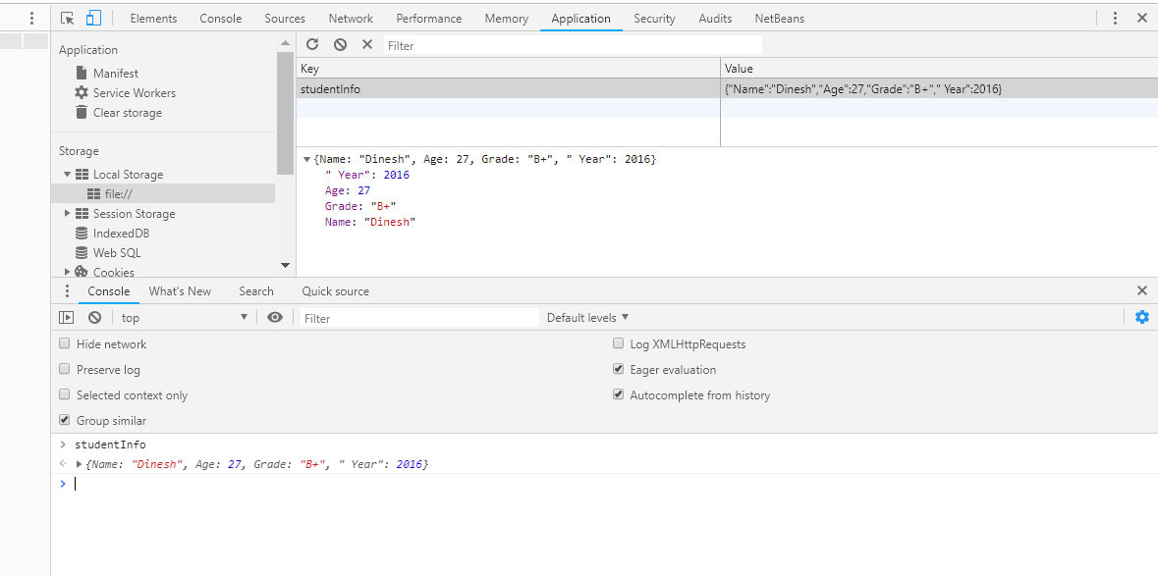
Use dev tool for debugging
Click on “Application” tab

Slide 6
JSON
JavaScript Object Notation
A syntax for storing and exchanging data
Use JSON.stringify() to make a JavaScript object to a string notation (localStorage accepts strings)
e.g.)
//create an object
var studentInfo = {
"Name": “Dinesh",
"Age": 27,
"Grade": B+,
" Year": 2016
};
//store using stringfy function
localStorage.setItem("studentInfo", JSON.stringify(studentInfo));

Slide 7
JSON object
{
“key1": value1,
“key2": value2,
….
“keyN”: valueN
}
Key/value separated by colon
Attributes separated by commas

Slide 8
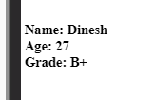
Retrieving JSON objects
Use JSON.parse() to (re)create an object from the string notation
//get JSON object
var studentInfo = JSON.parse(localStorage.getItem("studentInfo"));
var name = studentInfo.Name; // note the letter cases
var age = studentInfo.Age;
var grade = studentInfo.Grade;
document.getElementById("display").innerHTML += "<br>Name: " + name
+ "<br>Age: " + age
+ "<br>Grade: " + grade;

Slide 9
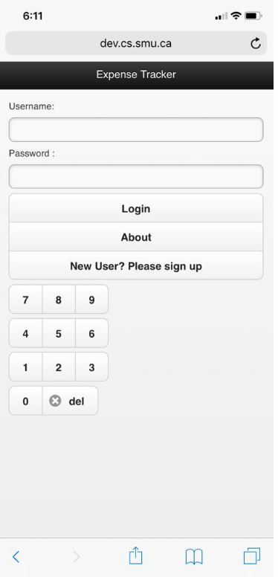
Expense Tracker App
/** Function to redirect the page on click og login**/
function redirectPage() {
var password = getPassword();
var userName = getUserName();
console.log(password);
console.log(userName);
//if the password matches
if (document.getElementById("passcode").value === password && document.getElementById("username").value === userName )
{
//if not agreed yet
if (localStorage.getItem("agreedToLegal") === null) {
$("#btnEnter").attr("href","#legalNotice").button();
}
else if (localStorage.getItem("agreedToLegal") === "true")
{
$("#btnEnter").attr("href","#pageMenu").button();
}
}
else {
alert("Incorrect username/password, please try again.");
}
}

Slide 10
Cont’d…
JSON.parse(localStorage.getItem("user")) will return an JavaScript object
.NewPassword is an attribute of the object
/** Function to get the password from the localStorage **/
function getPassword() {
if (typeof (Storage) === "undefined") {
alert(
"Your browser does not support HTML5 localStorage. Try upgrading."
);
}
else if (localStorage.getItem("user") !==null) {
return JSON.parse(localStorage.getItem("user")).NewPassword;
} else {
/*Default password*/
return "9999";
}
}

Slide 11
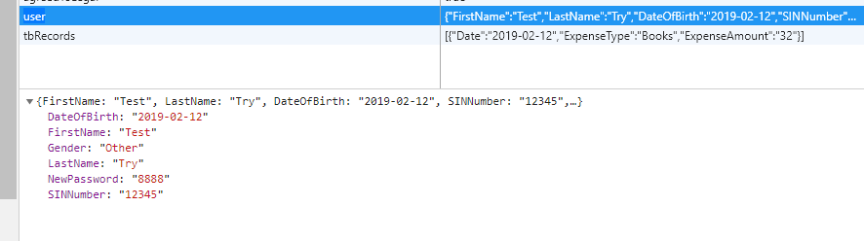
JSON object in Expense Tracker app
Needed for Assignment
FirstName LastName DateOfBirth NewPassword Gender SIN Number
var user = {
"FirstName": $("#signupFirstName").val(),
"LastName": $("#signupLastName").val(),
"DateOfBirth": $("#dateOfBirth").val(),
"SINNumber": $("#signupsinNumber").val(),
"NewPassword": $("#confirmPassword").val(),
"Gender": $("#signgenderType option:selected").val() };

Slide 12
Cont’d…
Once the password is retrieved from the local storage (or default “9999”),
check to see if it matches the value entered:
if (document.getElementById("passcode").value === password) {
……
} else {
alert("Incorrect password, please try again.");
}

Slide 13
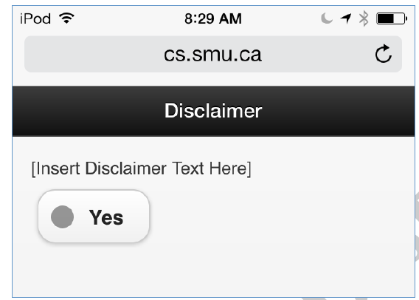
Cont’d…
Save it to the storage!
{ localStorage.setItem("agreedToLegal","true");
$.mobile.changePage("#pageMenu");
window.location.reload();
}

Slide 14
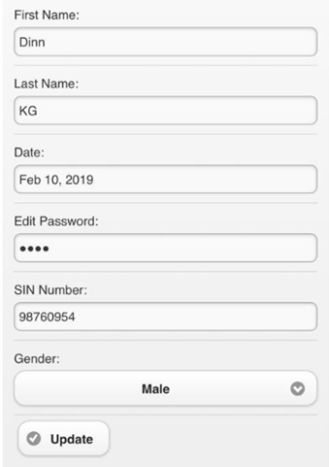
<form id="frmUserForm" action="">
<!---- code here -->
<input type="submit" id="btnUserUpdate" data-icon="check" data-iconpos="left" value="Update" data-inline="true" onclick="saveUserForm()">
</form>
//Function to save the user Information on click of Update
function saveUserForm() {
<!----code here ---->
}

Slide 15
Cont’d…
required
Only works within the form tag with submit
New in HTML5, and bit scratchy in Safari and earlier versions of others
When present, it specifies that an input field must be filled out before submitting the form – it doesn’t trigger the submit event
Only works with text, search, url, tel, email, password, date pickers, number, checkbox, radio, and file.
<label for="txtFirstName">First Name: </label>
<input type="text" placeholder="First Name" name="txtFirstName" data-mini="false" id="txtFirstName" value="" required>

Slide 16
saveUserForm()
function saveUserForm() {
var user = {
"FirstName": $("#txtFirstName").val(),
"LastName": $("#txtLastName").val(),
"DateOfBirth": $("#txtdateOfBirthInfo").val(),
"SINNumber": $("#txtSinNumber").val(),
"NewPassword": $("#changePassword").val(),
"Gender": $("#txtgenderType option:selected").val()
};
try {
localStorage.setItem("user", JSON.stringify(
user));
alert("Saving Information");
window.location.reload();
} catch (e) {
/* Google browsers use different error
* constant
*/
if (window.navigator.vendor ===
"Google Inc.") {
if (e == DOMException.QUOTA_EXCEEDED_ERR) {
alert(
"Error: Local Storage limit exceeds."
);
}
} else if (e == QUOTA_EXCEEDED_ERR) {
alert("Error: Saving to local storage.");
}
console.log(e);
}
}

Slide 17
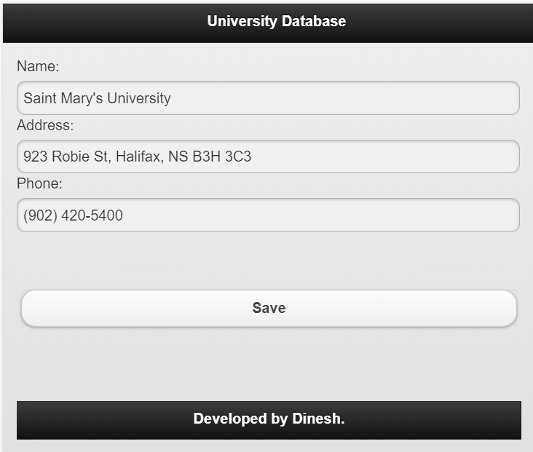
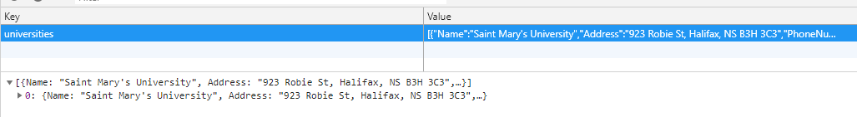
Activity #1
Write an app that can store an array of “university” objects in the local storage
Each object should have the following attributes:
Name
Address
PhoneNumber

Slide 18
JSON object for university
//create an object
var newObj = {
"Name": $("#name").val(),
"Address": $("#address").val(),
"PhoneNumber": $("#phone").val()
};

Slide 19
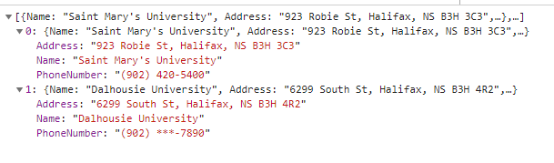
Check if universities array already exists:
var universities = localStorage.getItem("universities");
// no data stored yet, create a new one
if (universities == null) {
universities = [];//if not found, create a new array
}
else {
universities = JSON.parse(universities); //if found convert back to a JSON object
}//end if-else
universities.push(newObj); //now add the new object
//the save its string representation
localStorage.setItem("universities", JSON.stringify(universities));

Slide 20
Value validation (Expense Tracker App)
/** Validate the User Form **/
function validateUserForm() {
var currentDate = new Date();
var dd = currentDate.getDate();
var mm = currentDate.getMonth() + 1;
var yyyy = currentDate.getFullYear();
if (dd < 10) {
dd = '0' + dd;
}
if (mm < 10) {
mm = '0' + mm;
}
currentDate = mm + '/' + dd + '/' + yyyy;
//Check for empty fields in the form
if (
($("#signupFirstName").val() != "") &&
(newPassword!= "") &&
(confirmPassword!= "") &&
($("#dateOfBirth").val() <= currentDate) &&
($("#signupLastName").val() != "") &&
($("#signupsinNumber").val() != "") &&
($("#dateOfBirth").val() != "") &&
($("#signgenderType option:selected").val() != "Choose Gender")) {
return true;
} else {
return false;
}
}
}

Slide 21
Date calculation ?
//for finding current date
var d = new Date();
var month = d.getMonth() + 1;
var date = d.getDate();
var year = d.getFullYear();
var currentDate = year + '/' + (('' + month).length < 2 ? '0' : '') + month + '/’ +
(('' + date).length < 2 ? '0' : '') + date;

Slide 22
Activity #2
Modify the university DB app by adding value validation function
All fields required
Phone number only contains numbers (or hyphens)
Address starts with a number and contains at least one alphabet letter

Slide 23
All required – Easy!
//first get the values from the fields
var name = $("#name").val();
var address = $("#address").val();
var phone = $("#phone").val();
//check empty fields
if (name == '') {
alert("Please enter the name of the university!");
$("#name").focus();
return false;
}
if (address == '') {
alert("Please enter the address of the university!");
$("#address").focus();
return false;
}
if (phone == '') {
alert("Please enter the phone number of the university!");
$("#phone").focus();
return false;
}

Slide 24
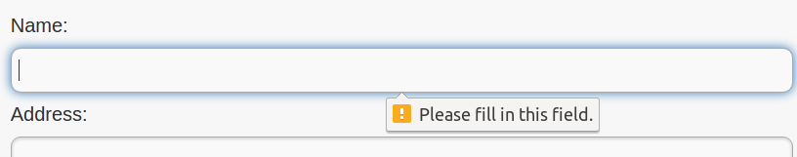
Or use <form> and required
<form>
<label for="name">Name:</label>
<input id="name" type="text" required>
<label for="address">Address:</label>
<input id="address" type="text" required>
<label for="phone">Phone:</label>
<input id="phone" type="tel" required>
<input type="submit" id="saveButton" value="Save">
</form>

Slide 25
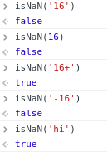

Only numbers and hyphens
isNaN(str) function
Whether the argument is NOT a number
But can’t use it with hyphens in between!
First split the string using ‘-’ as a delimiter
var tokens = phone.split('-');

Slide 26
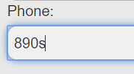
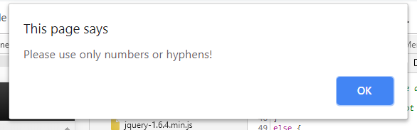
Cont’d…
Now go through each “part” of the string
var tokens = phone.split('-');
for (var i = 0; i < tokens.length; i++) {
if (isNaN(tokens[i])) {
alert("Please use only numbers or hyphens!");
$("#phone").focus();
return false;
}//end if
}//end for

Slide 27
Starts with a number
Get the 1st character:
trim() first trims leading and trailing spaces
substr(0,1) returns the 1st character in the string
Now use isNaN():
var firstChar = address.trim().substr(0, 1);
if (isNaN(firstChar)) {
alert("Address should start with a number!");
$("#address").focus();
return false;
}

Slide 28
Contains an alphabet letter
RegExp
In JavaScript, a regular expression is an object that describes a pattern of characters.
Used to perform pattern-matching
(More info: http://www.w3schools.com/jsref/jsref_obj_regexp.asp)
var pattern = /[a-z]/i
A pattern is enclosed in / /
[] denotes range: [a-z] characters from a to z
i is for case-insensitive

Slide 29
Cont’d…
test(str) function of RegEx:
Returns whether the argument contains the pattern
var pattern = /[a-z]/i;
if (!(pattern.test(address))) {
alert("Address should contain letters!");
$("#address").focus();
return false;
}

Slide 30
Exception handling in JavaScript
try{
// Code that does the disk operations
}
catch(variable)
{
// Code if the disk operations fail for any reason
}

Slide 31
Assign user’s attributes to the form fields
if (user != null) {
$("#txtFirstName").val(user.FirstName);
$("#txtLastName").val(user.LastName); $("#txtdateOfBirthInfo").val(user.DateOfBirth);
$("#txtSinNumber").val(user.SINNumber);
$("#changePassword").val(user.NewPassword);
$('#txtgenderType option[value=' + user.Gender + ']').attr('selected', 'selected');
$("#txtgenderType option:selected").val(user.Gender);
$('#txtgenderType').selectmenu('refresh',true);
}

Slide 32
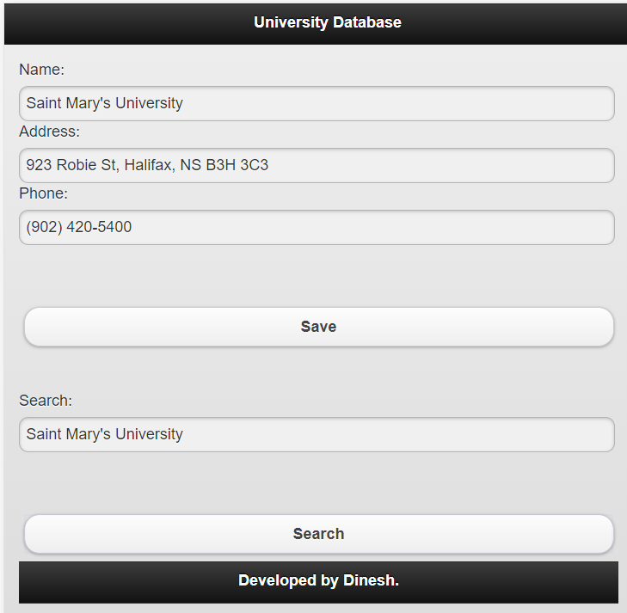
Activity #3 (university DB app)
Now add a feature to search objects by the “Name” and fills all the fields with the attributes when the record is found

Slide 33
Cont’d…
If no array object, no record, of course
//check if exists
var universities = localStorage.getItem("universities");
if (universities == null) {
//no record whatsoever, let the user know
alert("No record found");
}

Slide 34
Cont’d…
else {
//if data exist, convert to JSON object
universities = JSON.parse(universities);
//go through each record
for (var i = 0; i < universities.length; i++) {
var name = universities[i].Name;//Name attribute

Slide 35
Cont’d
//if the name matches
if ($('#searchKey').val().toLowerCase() == name.toLowerCase()) {
var address = universities[i].Address; // Address attribute
var phone = universities[i].PhoneNumber; //PhoneNumber attribute
//now fill the fields
$("#name").val(name);
$("#address").val(address);
$("#phone").val(phone);
return;//job done, get outa here
}//end if
}//end for
alert("No record found");

Slide 36
Records in the Expense Tracker app
The idea is the same as university objects:
tbRecords is an array of “records”
var record = {
"Date": $('#datExpenseDate').val(),
"ExpenseType": $('#txtType').val(),
"ExpenseAmount": $('#txtAmount').val()
};
var tbRecords = JSON.parse(localStorage.getItem("tbRecords"));
if (tbRecords == null) {
tbRecords = [];
}
tbRecords.push(record);
localStorage.setItem("tbRecords", JSON.stringify(tbRecords));

Slide 37
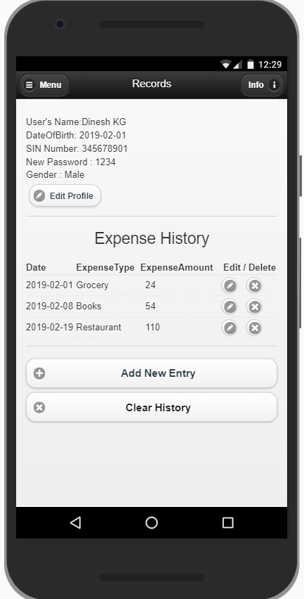
Cont’d…
And to retrieve and fill the record form:
function showRecordForm(index) {
try {
var tbRecords = JSON.parse(localStorage.getItem("tbRecords"));
var rec = tbRecords[index];
$('#datExpenseDate').val(rec.Date),
$('#txtType').val(rec.ExpenseType),
$('#txtAmount').val(rec.ExpenseAmount)
}

Slide 38
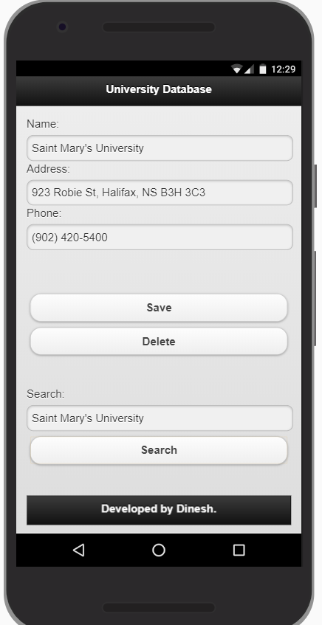
Activity #4
Add a delete function to the university app

Slide 39
Cont’d…
We can use pretty much the same code as search, except for…
//use name field instead of searchKey
if ($('#name').val().toLowerCase() == name.toLowerCase()) {
//remove item at i, 1 object
universities.splice(i, 1);
if (universities.length == 0) {
/* No items left in records, remove entire
* array from localStorage
*/
localStorage.removeItem("universities");
} else {
//otherwise save it back
localStorage.setItem("universities", JSON.stringify(universities));
}
alert("Record deleted");
//now clean up the form
$("#name").val('');
$("#address").val('');
$("#phone").val('');
return;//job done, get outa here

Slide 40
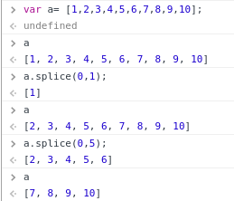
Cont’d…
array.splice(index,numItemsToRemove)
Remove numItemsToRemove, item(s) at index
Returns an array of item(s) removed

Slide 41
Expense tracker app record deletion
try {
var tbRecords = JSON.parse(localStorage.getItem("tbRecords"));
tbRecords.splice(index, 1);
if (tbRecords.length == 0) {
/* No items left in records, remove entire
* array from localStorage
*/
localStorage.removeItem("tbRecords");
}
else {
localStorage.setItem("tbRecords", JSON.stringify(tbRecords));
}
}

Slide 42
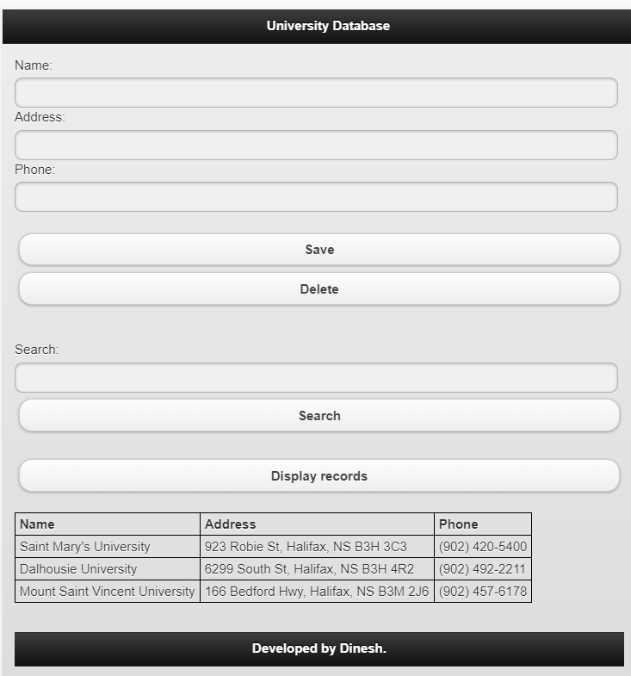
Activity #5 (university app)
Add a function to show all the university records in a table

Slide 43
Cont’d…
Similar code again, but instead of search, we go through all the records
First insert the table header:
//Initializing the table
$("#displayTable").html(
" <tr>" +
" <th>Name</th>" +
" <th>Address</th>" +
" <th>Phone</th>" +
" </tr>"
);

Slide 44
Cont’d…
Now start adding data rows:
//use a familiar general JS table object from here
//the expense tracker app uses a different way
var table = document.getElementById('displayTable');
//go through each record
for (var i = 0; i < universities.length; i++) {
var name = universities[i].Name;//Name attribute
var address = universities[i].Address; // Address attribute
var phone = universities[i].PhoneNumber; //PhoneNumber attribute
var r = table.insertRow();
r.insertCell(-1).innerHTML = name;
r.insertCell(-1).innerHTML = address;
r.insertCell(-1).innerHTML = phone;
}//end for

